Slide 2
PMA – Grade 2
Facts – Cards

Slide 3
Facts
What’s involved:
Counting forward and backward
Recognizing numbers
Determining quantity
Adding
Greater than and less than
Why it matters:
Builds efficient computation, which can lead to stronger number sense and flexible thinking
Children who know their facts can spend more time using their memory to problem solve

Slide 4
Number: Facts
Materials
Deck of cards (DMTI Math Pack)
If you do not have a deck of cards, then cut out the cards on the Card Template.

Slide 5
Adding with Cards
Activity
Take all the cards 1 (ace) through 10 out and shuffle them.
Have the child pick three cards at random and do the following:
What are the numbers on the cards?
Starting on the left, place the cards from largest to smallest.
Add all the numbers together.
Use the sentence frame below:
“A ___ and a ___ compose a ___. And ___ more compose ___.”

Slide 6
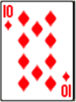
Adding with Cards
Example
What are the numbers on the cards?
Starting on the left, place the cards from largest to smallest.
Add all the numbers together.
Use the sentence frame below:
“A 10 and a 7 compose 17. And 5 more compose 22.”
“Five”, “Ten”, and “Seven”

Slide 7
Adding with Cards
Activity
Take all the cards 1 (ace) through 10 out and shuffle them.
Have the child pick three cards at random and do the following:
What are the numbers on the cards?
Starting on the left, place the cards from largest to smallest.
Add all the numbers together.
Now, starting on the left, place the cards from smallest to largest.
Is the sum (total) the same as before?

Slide 8
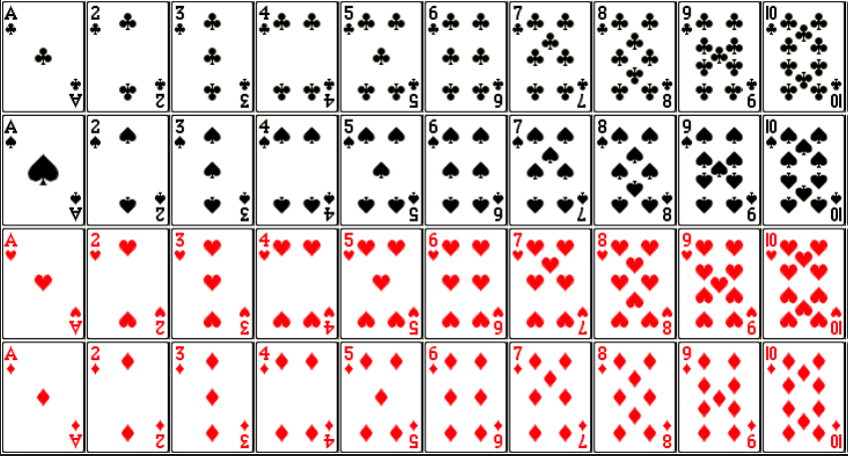
Cards Template
Notes:
The Ace is used as a 1.
Also note that what we call the figures are the clubs, spades, hearts, and diamonds. But, in geometry the diamond is actually a rhombus.

