Slide 2
PMA – Grade 2
Interpreting Context

Slide 3
Interpreting Context
What’s involved:
Creating a visual model to represent the story
Understanding what they know or don’t know in the problem
Problem solving how they will go about finding what is unknown
Why it matters:
Builds critical thinking and problem solving skills
Gives insight into what a student understands and how the student thinks
Highlights misconceptions that may be hidden with symbolic calculations

Slide 4
Interpreting Context
Directions for Activity I:
Look at each picture and ask your child what they see in general and then ask what math statement they can make.
Next, answer the set of questions that appear by clicking any key

Slide 5
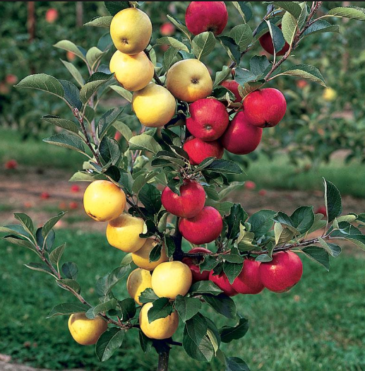
Interpreting Context
What do you see?
How many red apples?
How many yellow apples?
How many more yellow apples than red apples?
How many apples are there altogether?
- What is a number sentence that matches this question?
If you were to pick
- What would be a number sentence that matches this question?
Notes:
There are 7 red apples
There are (10 or 11) yellow apples.
There are (3 or 4) more yellow apples than there are red apples.
There are (17 or 18) apples altogether. 7 + 10 = 17 or 7 + 11 = 18
There are now (8 or 9) apples. 17 – 9 = 8 or 18 – 9 = 9

Slide 6
Interpreting Context
What do you see?
On Team 1 there are 24 people playing volleyball. If 16 of them are boys, how many girls are playing volleyball?
- What is a number sentence that matches this question?
There are 28 people on Team 2. How many total people are on both teams? - What is a number sentence that matches this question?
Notes:
There are 8 girls playing volleyball. 16 + 8 = 24 or 24 – 16 = 8 or 24 – 8 = 16 or 8 + 16 = 24
There are 52 total people playing volleyball. 24 + 28 = 52

Slide 7
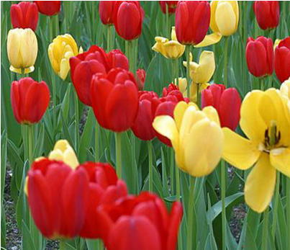
Interpreting Context
What do you see?
How many red tulips?
How many yellow tulips?
How many more red tulips than yellow tulips?
How many tulips are there altogether?
- What is a number sentence that matches this question?
If you were to give away ten tulips, how many tulips would there be?
- What would be a number sentence that matches this question?
Notes:
There are 18 red tulips.
There are 8 yellow tulips.
There is ten more red tulips.
There are 26 tulips altogether. 18 + 8 = 26
There would be 16 tulips. 26 – 10 = 16

Slide 8
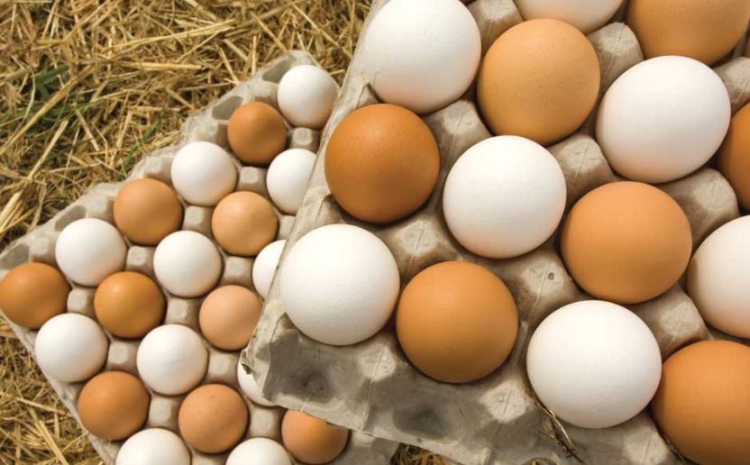
Interpreting Context
What do you see?
How many brown and white eggs can you see each?
How many more brown eggs are there than white eggs?
How many eggs are there altogether?
- What is a number sentence that matches this question?
The carton of eggs are five rows of six columns and the pattern of every other color egg is always the same. If this is true how many brown and white eggs are in one carton?
- What would be a number sentence that matches this question?
Notes:
There are 18 white eggs and 16 brown eggs.
There are 2 more white eggs than brown eggs.
There are 34 eggs altogether. 18 + 16 = 34
There are 15 white eggs and 15 brown eggs in each carton or 30 eggs altogether. 15 + 15 = 36 or the patter of each color is 1 + 3 + 5 + 4 + 2 = 15

Slide 9
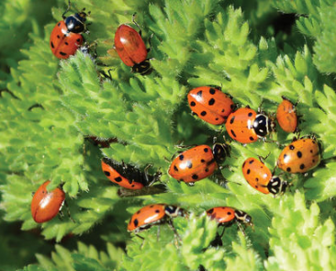
Interpreting Context
What do you see?
How many lady bugs do you see?
How many spots can you count?
If each lady bug has 4 spots on one side and 5 on the other, how many spots would that be on three lady bugs?
Write a number sentence that matches this question.
How many spots would there be total on all the ladybugs?
Notes:
There are 12 ladybugs.
There are about 54 spots
There would be 27 spots all together. 4 + 4 + 4 + 5 + 5 + 5 = 27
There would be 108 total spots.
Now read the book – Ten little ladybugs by Melanie Gerth

Slide 10
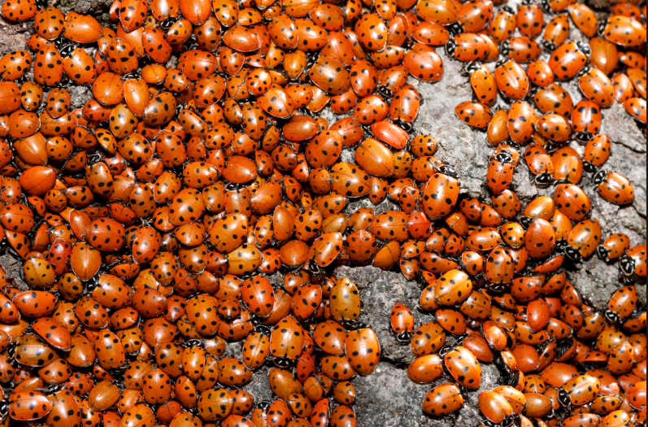
Interpreting Context
What do you see?
How many ladybugs do you think there are total?
What is way that we could predict the number of ladybugs?
Break the picture into smaller equal sections and try counting 1 section and then add them all up.
It looks like there are about 20 ladybugs in the top left section.
That would be 20 + 20 + 20 + 20 + 20 + 20 + 20 + 20 + 20 + 20 + 20 + 20 + 20 + 20 + 20 + 20 = 320

Slide 11
Interpreting Context
Directions for Activity II:
Now, as you are going to school, the store, the park, or anywhere, ask your child to look for things around them and describe them with a math statement.
For example, “I see four birds. 1 bird is flying and the other 3 are sitting.”
Try asking comparing questions with two different types of objects or people.

